Slide 1



US used cars data analysis (CIS 5200 | Final Project - Spring 2022) 05/11/2022
Group 4

Slide 2
Team Members
Aakriti Rupal
Phue Phue Thant
Vatsal Pancholi
Anish Omprakash Pandey

Slide 3
Project Agenda
Data and Server Specifications
Basic commands for Data Validation
Geo Spatial Visualization
Project Architecture and Workflow
Analysis of Factors Affecting Used Car Price
Exploratory/ Descriptive Analysis
Explanation of the Project Idea

Slide 4
Data Description
Total number of columns:
66 columns
Data Source URL:
https://www.kaggle.com/ananaymital/us-used-cars-dataset
Total number of rows/records:
2,974,151 records
Data size:
9.98 GB

Slide 5
Basic Specifications
Cluster version: Hive 3.1.2-amzn-4
Memory size: 58.58 GB
CPU speed: 8 Core CPU (Intel(R) Xeon(R) Platinum 8167M CPU @ 2.00GHz)
Cluster number of nodes:
3 node cluster

Slide 6













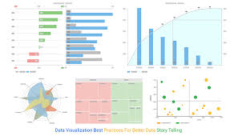
Project Architecture
Data Source
Data validation and analysis
Data Analysis Preparation
Data Analysis Download
Data Visualization

Slide 7
Project Workflow
Data sourcing
Sourced the data from Kaggle
Split the large dataset into small manageable .csv files
Data preparation
Standardized data types for consistency across all columns
Loaded data to HDFS using scp (windows) and sftp (mac)
Data validation and analysis
Ran select (*) and count (*) commands to ensure the completeness of data
Performed data analysis using HiveQL commands
Data analysis download
Downloaded the analysis as a .csv file to our personal computers using scp (windows) and sftp (mac) connections for data visualization.
Data visualization
Used bar charts, line graphs and excel 3-D maps for visual representation of the analysis

Slide 8
Explanation of the Project Idea
Data Overview: The dataset was generated in September 2020, using data from Cargurus website. The dataset has ~ 3 million records of used cars across the US and 66 columns.
Why this project?
Study patterns of used cars sold in the US by analyzing a large number of data points (Bigdata)
Analyze effect of different factors (mileage, model, year, etc.) on price of used cars.
Used car price is complex as it depends on number of factors. The existing analysis can be extended to predict/ validate car prices using various parameters.
Utilized class concepts of HIVE and data analytics to gain insights that would not have been possible using traditional excel/ tableau tools as it would not have scaled for the large dataset (Big data) that we used.

Slide 9
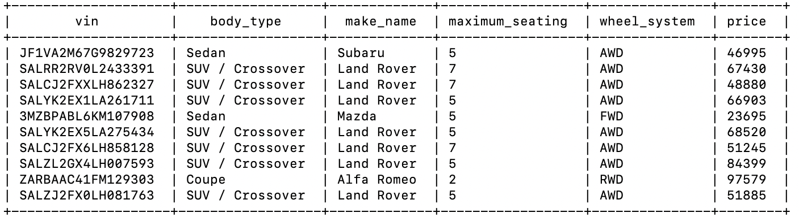
Basic Commands for Data Validation
Select command shows the vin, body type, make name, maximum seating, wheel system and price from the US used cars dataset
Hive>> select vin, body_type, make_name, maximum_seating, wheel_system, price from used_cars LIMIT 10;

Slide 10
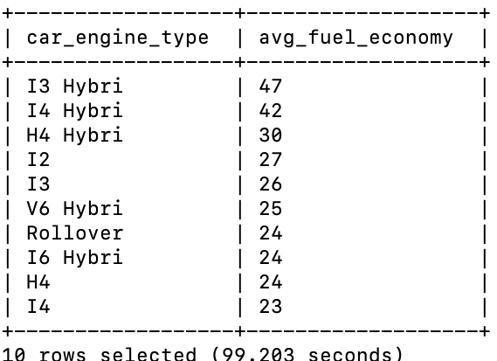
Descriptive Analysis (Car size engine vs fuel economy)
Effect of car engine size on fuel economy
Hive>> select engine_type AS car_engine_type, ceil(AVG(city_fuel_economy)) AS avg_fuel_economy from used_cars group by engine_type Order By avg(city_fuel_economy) DESC LIMIT 10;
Observation: The fuel economy of I3 hybrid is maximum.

Slide 11
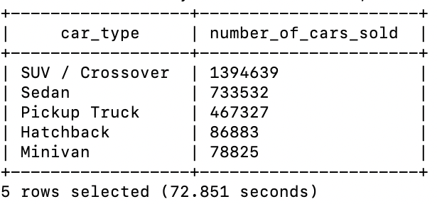
Descriptive Analysis (Car sold based on car type)
Number of cars sold based on the car type
Hive>> select body_type AS car_type, count(vin) AS number_of_cars_sold from used_cars group by body_type order by count(vin) desc limit 5;
Observation: SUVs followed by Sedans are the most preferred used car type

Slide 12
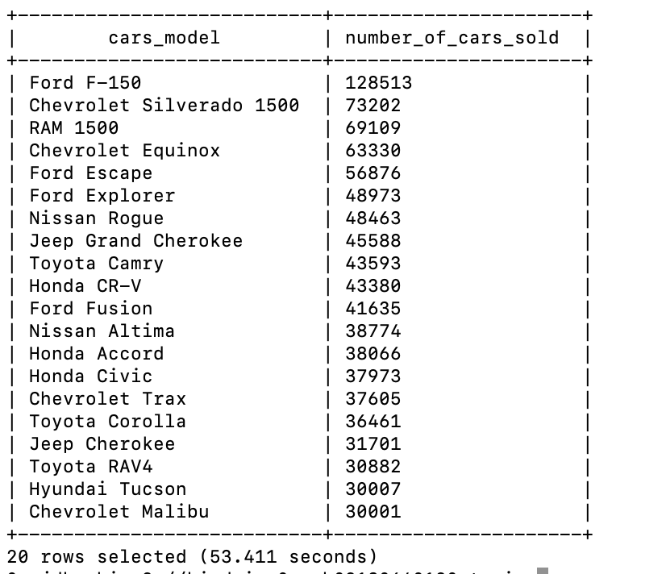
Descriptive Analysis (Car sold based on car model)
Number of cars sold based on the car model
Hive>> select CONCAT(make_name, " ", model_name) cars_model, count(vin) AS number_of_cars_sold from used_cars group by CONCAT(make_name, " ", model_name) order by count(vin) desc limit 20;
Observation: Ford F-150 and Chevrolet Silverando are the highest selling used car models

Slide 13
Descriptive Analysis (Car sold based on car model – Graphical Representation)
Hive>> INSERT OVERWRITE DIRECTORY '/user/arupal/data/' ROW FORMAT DELIMITED FIELDS TERMINATED BY ',' select CONCAT(make_name, " ", model_name) AS cars_model, count(vin) AS number_of_cars_sold from used_cars group by CONCAT(make_name, " ", model_name) order by count(vin) desc limit 20;
Observation: Ford F-150 and Chevrolet Silverando are the highest selling used car models

Slide 14
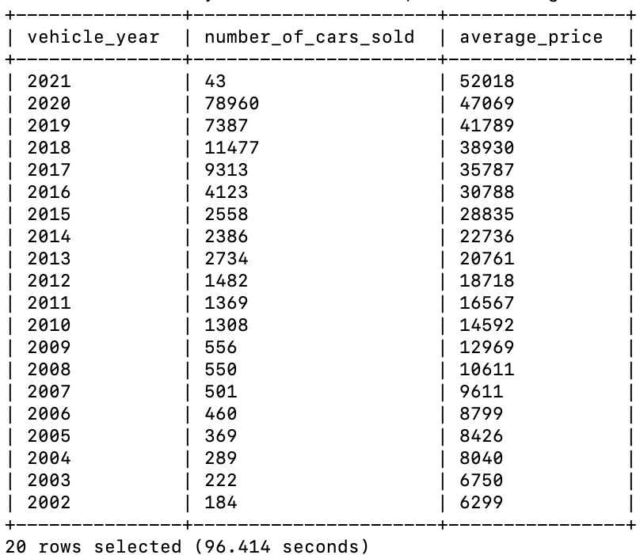
Descriptive Analysis (Average price of Ford F-150)
Number of cars sold and the average price of the car for different vehicle years for Ford F – 150?
Hive>>select vehicle_year, count(vin) AS number_of_cars_sold, ceil(avg(price)) AS average_price from used_cars where CONCAT(make_name, " ", model_name) = 'Ford F-150' group by vehicle_year order by vehicle_year desc limit 20;
Observation:
The average price of Ford- F-150 decreases as the vehicle-year increases

Slide 15
Descriptive Analysis (Average price of Ford F-150)
Observation:
The average price of Ford- F-150 decreases as the vehicle-year increases

Slide 16
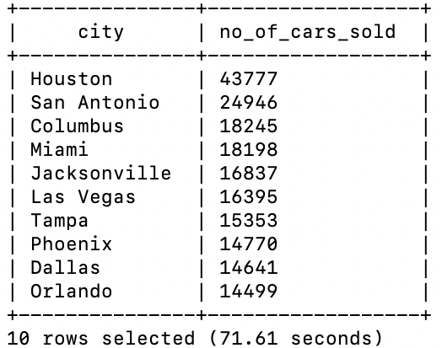
Descriptive Analysis (Sales distribution across cities)
Distribution of used cars sales across different cities in the US
Hive>> select city As city, count(vin) AS no_of_cars_sold from used_cars group by city order by count(vin) desc LIMIT 10;
Observation: The used car sales is highest in Houston.

Slide 17
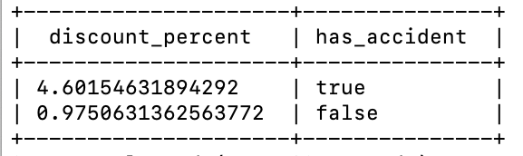
Analysis of Factors Affecting Used Car Prices (Car accidents)
Effect of a car accident on price of the car
Hive>> select avg(used_car_temp.savings_amount/used_car_temp.price)*100 discount_percent, used_car_temp.has_accidents has_accident from (select * from used_cars where mileage < 10000) used_car_temp where CONCAT(used_car_temp.make_name, " ", used_car_temp.model_name) = 'Ford F-150' AND used_car_temp.has_accidents IS NOT NULL group by used_car_temp.has_accidents;
Observation: The discount percent given by dealer increases if the car has had an accident.

Slide 18
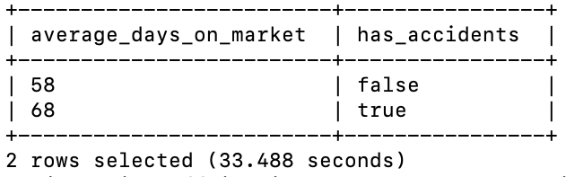
Descriptive Analysis (Effect of car accident on days on market)
Hive >> select ceil(avg(daysonmarket)) AS average_days_on_market, has_accidents from used_cars WHERE has_accidents IS NOT NULL group by has_accidents ORDER BY avg(daysonmarket);
Observation: The days on market of used cars with accidents is higher than cars with no accident history.

Slide 19
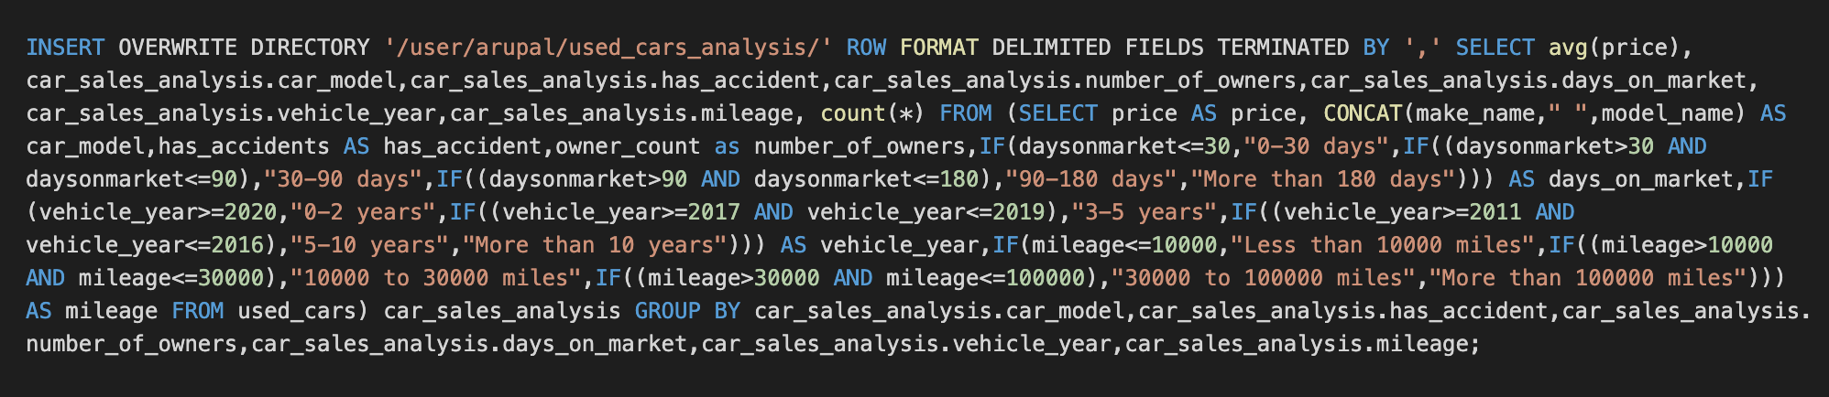
Analysis of Factors Affecting Used Car Prices
Analysis Methodology:
Selected potential attributes affecting car price - car type, has accidents, owner count, days on market, vehicle year and mileage
Created buckets or range of values for continuous variables/ factors
To analyze effect of one attribute, all other factors were kept constant and effect of that attribute on car price was determined
Analysis Table Data Export – Create analysis table using selected attributes

Slide 20
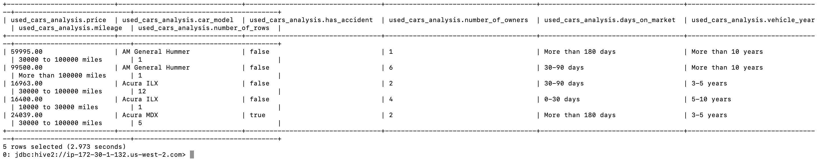
Create Analysis Table
Hive>> CREATE EXTERNAL TABLE IF NOT EXISTS used_cars_analysis (price DECIMAL(12,2), car_model VARCHAR(64), has_accident BOOLEAN, number_of_owners INTEGER, days_on_market VARCHAR(64), vehicle_year STRING, mileage VARCHAR(64), number_of_rows INTEGER) ROW FORMAT DELIMITED FIELDS TERMINATED BY ',' STORED AS TEXTFILE LOCATION '/user/arupal/used_cars_analysis';
select * from used_cars_analysis LIMIT 5;

Slide 21
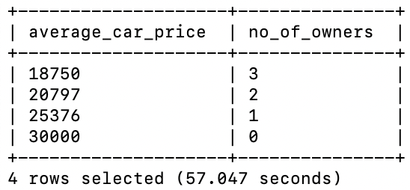
Analysis of Factors Affecting Used Car Prices (No of owners)
Hive>> select ceil(avg(price)) AS average_car_price, number_of_owners AS no_of_owners from used_cars_analysis where car_model = "Ford F-150" AND has_accident = FALSE AND mileage = "Less than 10000 miles" AND days_on_market = "0-30 days" AND vehicle_year = "5-10 years" group by number_of_owners ORDER BY avg(price);
Observation: The average price of the car decreases with an increase in the number of owners

Slide 22
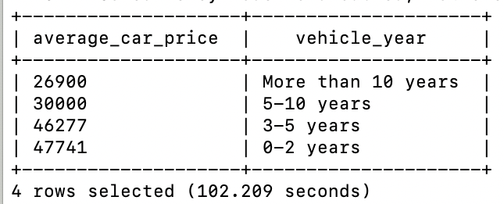
Analysis of Factors Affecting Used Car Prices (Vehicle year)
Hive >> select ceil(avg(price)) AS average_car_price, vehicle_year from used_cars_analysis where car_model = "Ford F-150" AND has_accident = FALSE AND number_of_owners = 0 AND days_on_market = "0-30 days" AND mileage = "Less than 10000 miles" group by vehicle_year ORDER BY avg(price);
Observation: The price of the car decreases for older models

Slide 23
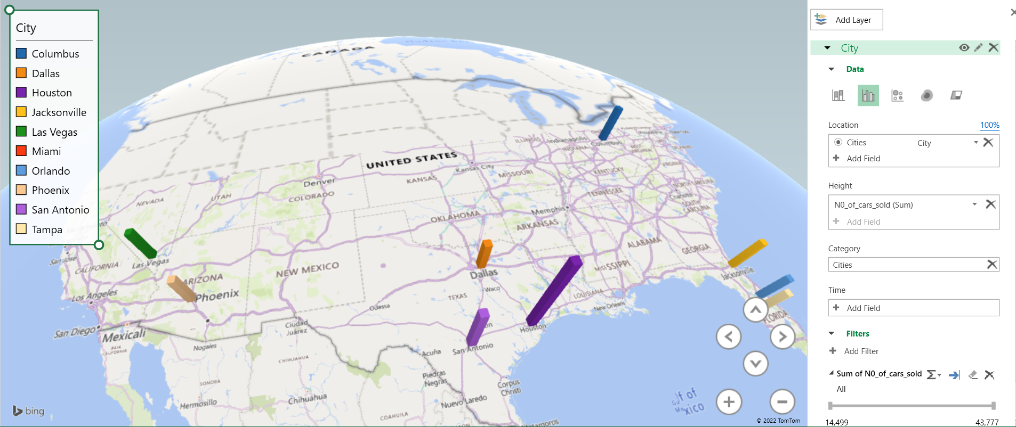
Geo Spatial visualization (Shows the used car sales distribution across cities)

Slide 24
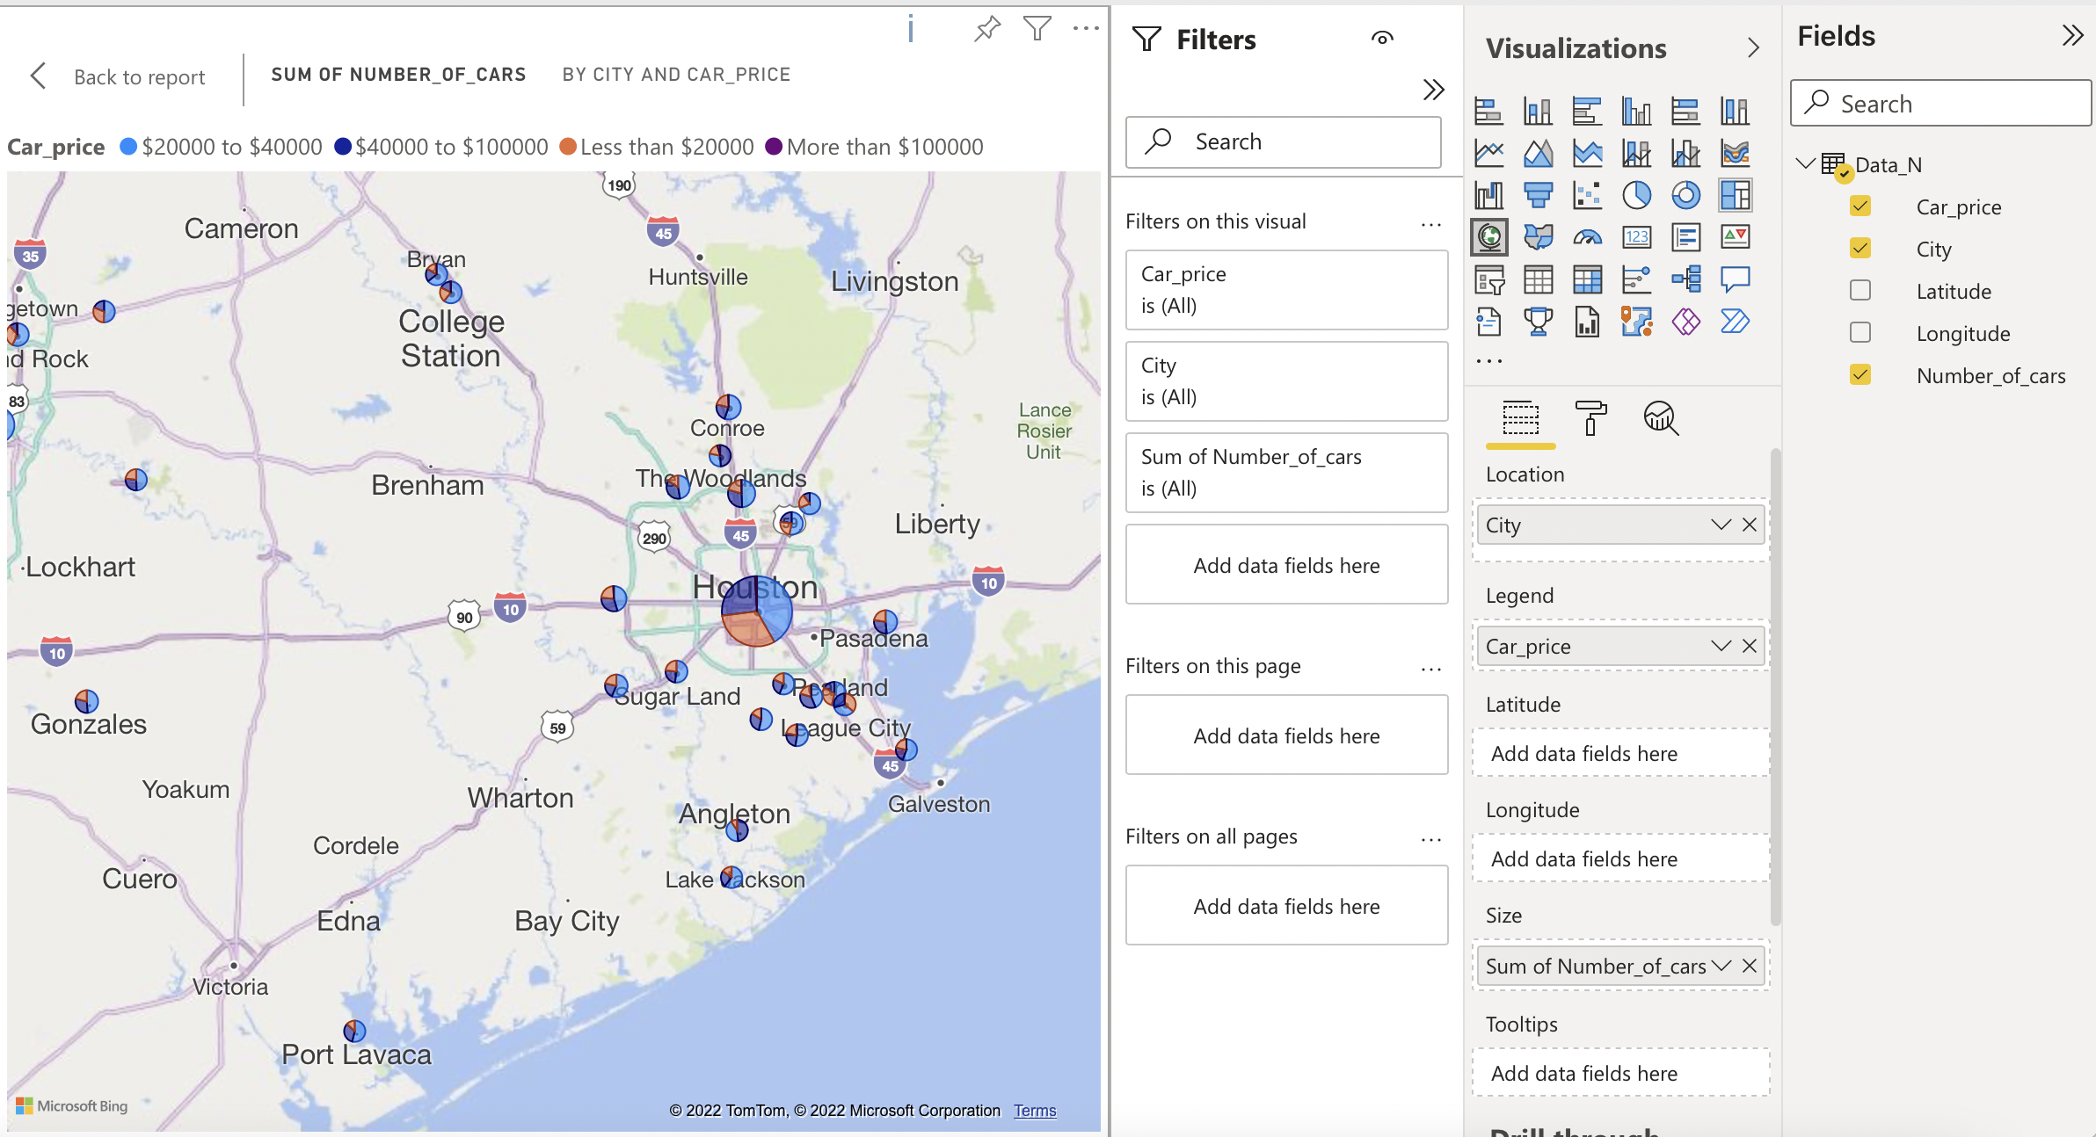
Geo Spatial visualization (Shows the used car price distribution across cities)

Slide 25
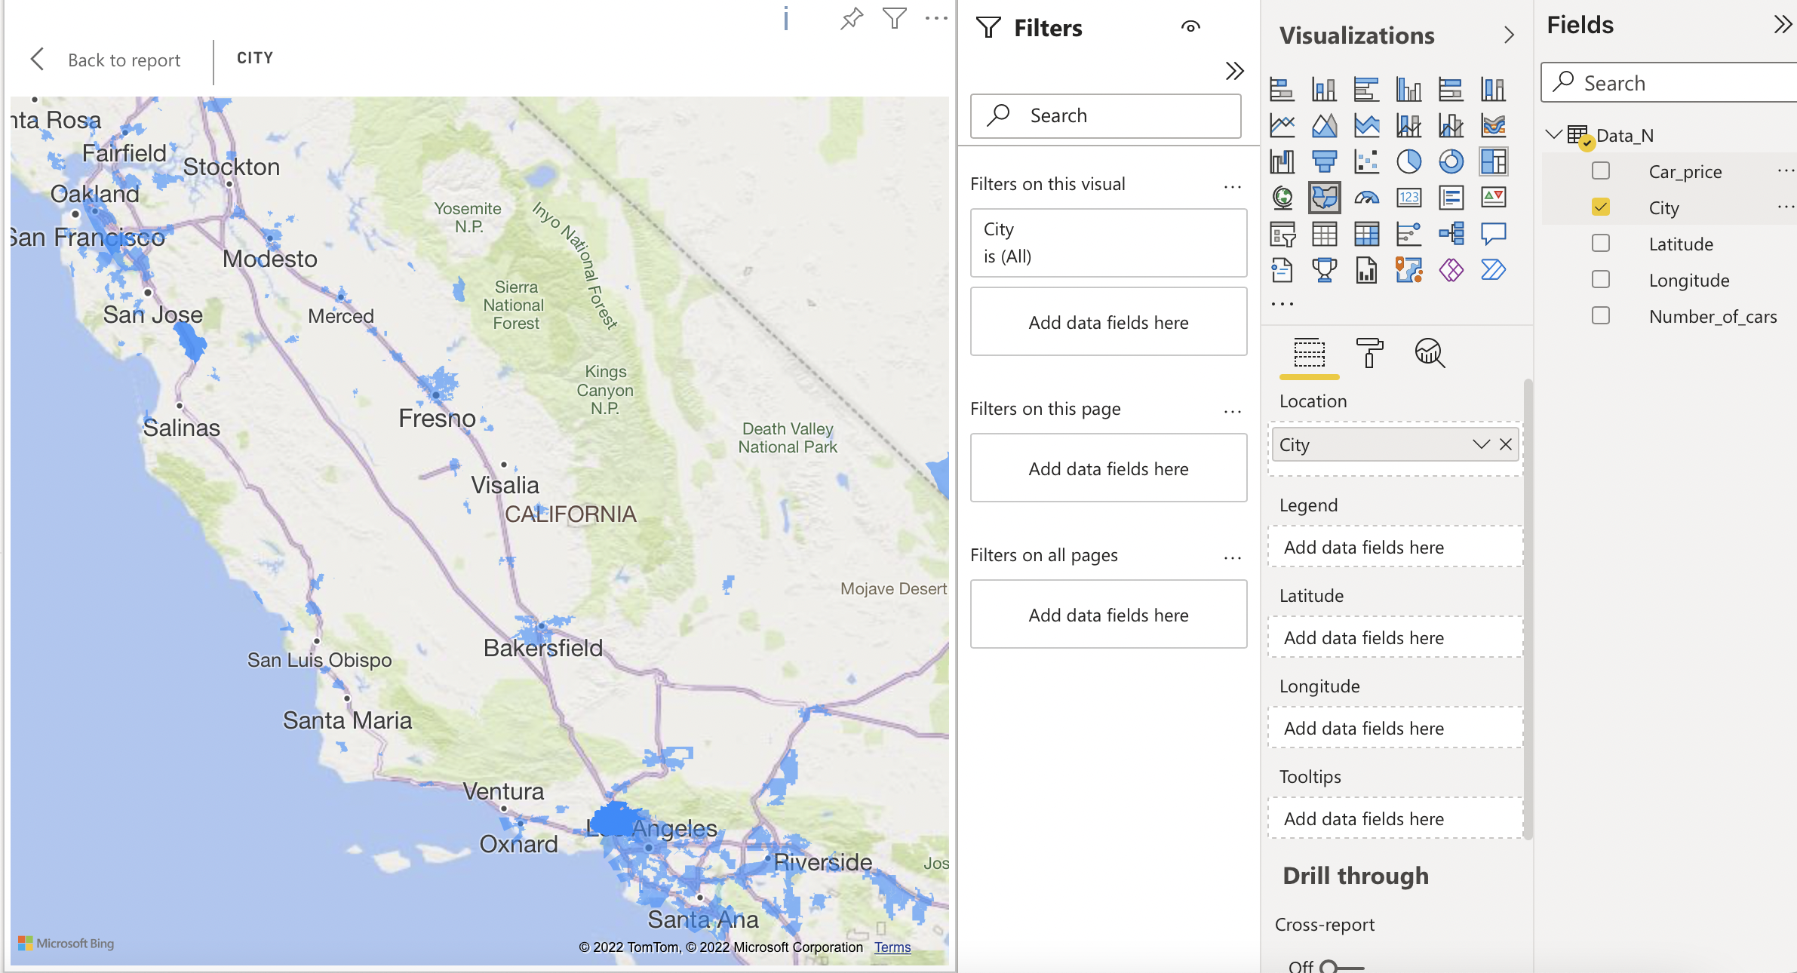
Geo Spatial visualization (Shows the used car sales distribution on the west coast)

Slide 26
Github Link
https://github.com/arupal23/CIS-5200-Project-Files/settings/access?query=filter%3Acollaborators

Slide 27

Thank you!

